Slide 1
Goodnotes recruiter Challenge
Raico wong

Slide 2
Recruitment presentation for payme from hsbc

Slide 3
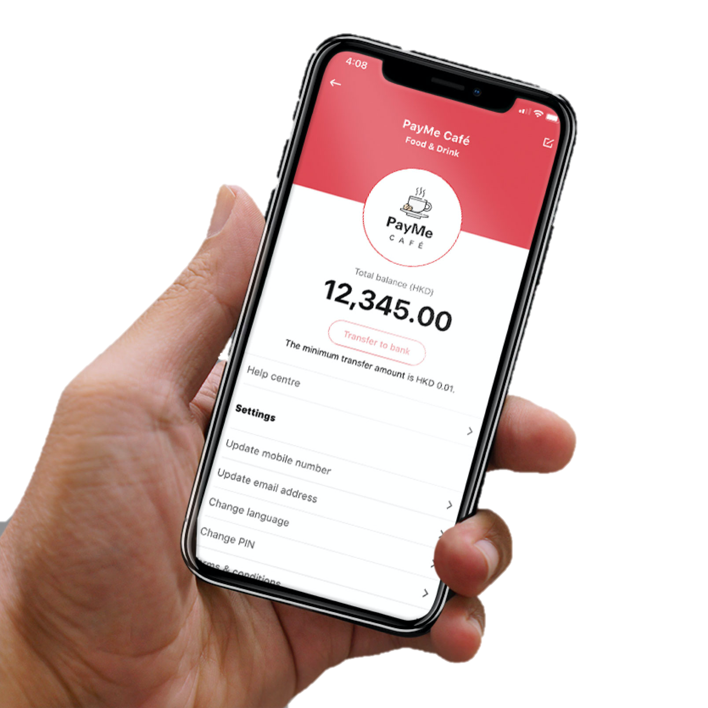
What is payme?
Launched in February 2017
PayMe, a mobile payment service from HSBC, currently available for Hong Kong users with local phone numbers and bank accounts
Support both PayMe user and non-PayMe user
PERSONAL (Person-to-Person)
BUSINESS (Person-to-Merchant)

Slide 4
Our Journey
PayMe Product Launched Feb 2017
Added Feature of Request Payment Oct 2017
Seasonal Feature of Red Packets Feb 2018
Reached One Million Users Jul 2018
Added Feature of PayCode Aug 2018
Introduced the Support of FPS and other Local Banks Jul 2019
Won the FinTech Grand Award Apr 2018
PayMe for Business Product Launched Mar 2019
Extended Service to Retail Businesses Aug 2020
Reached Two Millions Users May 2020
Added Feature of Face & Fingerprint ID Authorization Feb 2018
Added Feature of Customized PayLink Mar 2020

Slide 5
Top charts - Payme
Apple App Store
- Top 5 under the Finance Category
- Rated 4.7/5.0 over 220k Ratings
Google Paly Store
- Top 5 under the Finance Category
- Rated 4.3/5.0 over 25k Ratings

Slide 6
Payme for business
Launched in March 2019
Exceptional functions like real-time transaction report and easy refund
Working with merchants from different sectors, including but not limited to…
Local start-ups and SMEs, covering Food & Beverage, Fashion & Beauty, Education, Household Product / Service, etc.
eCommerce Platforms like SHOPLINE and HKTVmall
Charities like UNICEF, The Community Chest, and Tung Wah Group
Government Departments like Water Supplies, Inland Revenue, and Rating & Valuation Departments

Slide 7

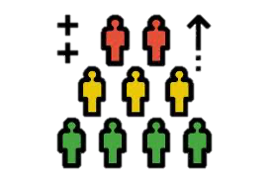
What are we achieving?
STARTING THE YEAR STRONG!
2020 Q1:
P2P transaction volume increased 10% on a quarterly basis and resulted as an increase of 30% YoY
Doubled up the P2M transaction volume on a quarterly basis
As of May 2020:
We had over two million of active users, out of the Hong Kong population of 7.3 million
We are holding 70% of the total market share in P2P payments and 70% of its transaction value in Hong Kong (and growing!)

Slide 8

Major Teams allocation – A team of 200
Strong team consists of diversified background from reputable businesses like PayPal, eBay, TransUnion, local and investment banks, etc.
Major teams are:
Technical Development
Consumer Product
Data & Insight
Design (UX/UI & Graphic)
Service Design (Customer Experience)
Growth Marketing
Sales & Distribution
Customer Service & Operations
Risk and Control

Slide 9

How do we work?
Emphasising Teams’ Interaction
Having faith in Self-management
Promoting End-to-end Ownership
Encouraging Creativity
Managing via Agile Methodology

Slide 10

Agile methodology
PayMe’s first MVP (Version 1.0):
Only allow top-up from credit cards
Only allow transfer and payment between PayMe users
More and better features have been built over time → Make sure every MVP is responding to the market’s wants and needs + launching in a timely manner
Features of Request Payment and Red Packets
Enable functions of PayCode and PayLink
Support Face ID and Fingerprint ID Authorization
Many more to come!

Slide 11

Where are we & How can we do better?
We are…
A leading digital payment application with 70% of market penetration
With a user-friendly Interface
Offering with on-going enhancement
Powered by HSBC's bank-standard security and fraud prevention technology
Charging a much lower handling fee for Business – 3% for credit card and PayPal VS 1.2-1.5% for PayMe
Features In progress…
We constantly get comments from our community of “PayMe Insiders” - our >18k active users for ideas and feedback on UX/UI

Slide 12
How do we stand out?
More than a FinTech Solution
More than a Digital Wallet
We are an eco-system
Static Data: Income, Address, Age, Gender, etc.
Dynamic Data: Transaction Volume, Monthly Expenditure, Spending Pattern, Personal Connection, etc.
With PayMe, we can fill up the supplementary dynamic data apart from users’ credit card transaction and bank record.
We can also cover the details of users’ personal network.

Slide 13

We’re #better2gether!
Keen to grow with us and build something big? Act now and get in touch!

